Slide 1
Exploring Rich Data and Long Data to Understand Collaboration
Giuseppe (Peppo) Valetto

Slide 2
The gist
My interest: coordination and collaboration in Virtual Organizations
I am a Software Engineer, so I study SW development VOs
Today: how to use data from traces of individual and collaborative activities to study SW teams
Rich data
Long data
(getting) Big data, too
The goal: to discover and understand emergent teamwork in virtual software development organizations

Slide 3
SW development Virtual Organizations
VOs are ubiquitous in software industry
Open Source Software (OSS) communities
Large multi-national SW factories
Off-shoring and outsourcing
Consulting gigs
Coordination overhead paid by VOs has been known to negate economies of scale in industrial SW development settings
Not so in Open Source settings
This has become a powerful driver for academic research

Slide 4
SW questions that matter
Some questions developers ask all the time *:
Who is working on what?
What is my co-worker Alice working on right now?
Who changed this code?
What modules has my team been working on?
Who is working on the same modules as I am and for which work item?
Who to talk to when I have to work with modules I haven't worked with?
Answering these questions enables better coordination, but requires better awareness
* T.Fritz and G.C. Murphy: “Using Information Fragments to Answer the Questions
Developers Ask” – ICSE 2010

Slide 5

Coordination and awareness
Coordination is a cost and an overhead
it is also obviously a necessity
Awareness is a “state of mind”
It is multi-faceted:
Awareness of the need to coordinate with specific colleagues
Awareness of the colleagues’ work and how it relates to my own work …
“Much lack of coordination
in you, I sense”
©LucasFilm Limited

Slide 6
SW development Virtual Organizations
Team work in these VOs does not follow hierarchical or “turf” considerations
Dependencies and modularity of the SW product have a strong impact on how developers work together
And they are clearly defined but volatile
Truly a socio-technical system:
Inextricable inter-play between technical and organizational aspects [Conway 1968] [Parnas 1972]

Slide 7
SW development data
Traces of what happens in these VOs are …
Long: some OSS projects are going on since 10 years or more
Rich: traces of work are very detailed and strongly contextualized
within carefully defined text
around very well structured artifacts
Many repositories to be fused and mined together
Many questions can be asked of those repositories

Slide 8
Today’s problem: team awareness
Team awareness:
How to detect emergent teams of collaborators in a SW VO
(in an actionable way)

Slide 9
The data: contextualized interactions in SE
Traces of developer interactions with the SW artifacts
In a SW VO, predecessors to personal interactions
SW development work is artifact-oriented
State-of-the-art-tools technology enables recording of fine-grained developers’ actions in their IDEs
Example: the Mylyn Eclipse plugin
one of the most downloaded Eclipse plugins
Goal is to support the individual developer
Collects “task contexts”

Slide 10
The data: contextualized interactions in SE
Example of Mylyn task context record
Decorates work actions with: task, timestamp, kind of interaction, artifact, granular SW element …
<InteractionHistory Id="https://bugs.eclipse.org/bugs-WXYZ" Version="1"><InteractionEvent Delta="null" EndDate="2008-11-17 14:37:22.96 PST" Interest="1.0" Kind=”selection” StartDate="2008-11-17 14:37:22.96 PST" StructureHandle=“org.eclipse.mylyn.pde.ui/src.org.eclipse.mylyn.internal.pde.ui {PdeUiBridgePlugin.java[PdeUiBridgePlugin~lazyStart" StructureKind="java"/>

Slide 11
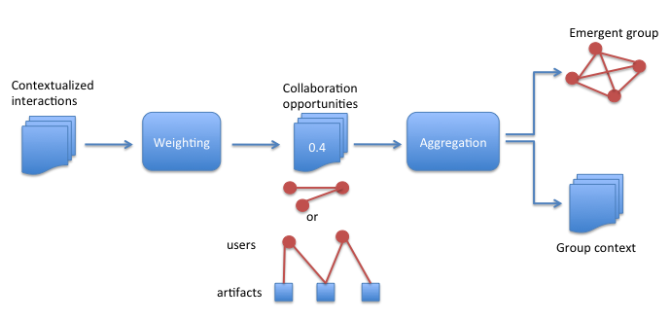
The method
Goggins, Valetto, Mascaro, and Blincoe, K. 2012.
“Creating A model of the Dynamics of Socio-Technical Groups using Electronic Trace Data”.
From contextualized interactions …
… to collaboration opportunities …
… to emergent groups

Slide 12


Collaboration opportunities
Intersections produce collaboration opportunities network
I_{x} = (Task₁, Task₂, Task₃, …) →
(Art_{a}, Art_{b}, … , Art_{n});
Bipartite weighted network
Developer-to-intersection
Developer A
Developer B
Assigned to Task 1
Assigned to Task 2
Task 1
Working Set
Task 2
Working Set
Working set intersection

Slide 13
Collaboration opportunities network
…
Developer A
Developer B
Developer K
Assigned to Task 3
Assigned to Task 1
Assigned to Task 2
I_{x} = (Task₁, Task₂, Task₃, …) → (Art_{a}, Art_{b}, … , Art_{n});

Slide 14
Group identification
We manipulate the bipartite collaboration opportunities network to obtain a person-to-person network
We use the SNA concept of bi-cliques
subsets of developers that have many incident arcs onto the same artifact intersections
We look for cohesive structures in the person-to-person network
Steps:
dichotomize collaboration opportunities network
compute bi-cliques (sets of developers who gravitate towards common work artifacts)
compute structural correlation matrix (which developers take part in the same bi-cliques)
Create weighted person-to-person network with high correlation coefficients (cut-off factor)

Slide 15
Empirical work
We mined Mylyn repositories:
1,970 tasks (Bugzilla)
450,747 task context events (Mylyn)
8 releases with 13 to 18 developers in each (SVN)
Control data: talk
ML and Bugzilla conversations for over 400 Mylyn community participants
We compare our “work networks” vs. talk networks

Slide 16
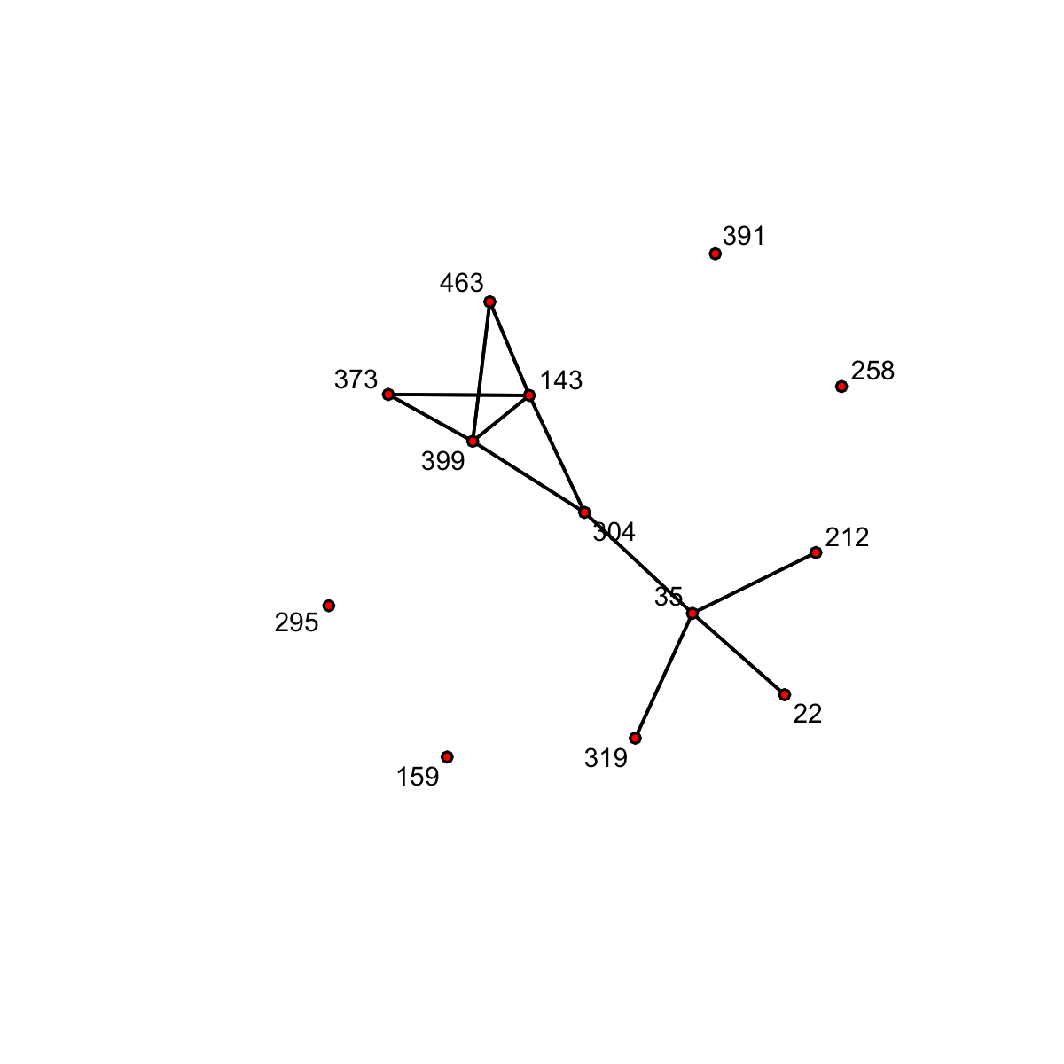
Work network
From bipartite network …
254 intersections and 1500+ arcs
… to much simpler network
Easy-to-spot groups
Correlation cut-off is 0.4
WG1:
Strong 2-clique
WG2:
Vulnerable 2-clique

Slide 17
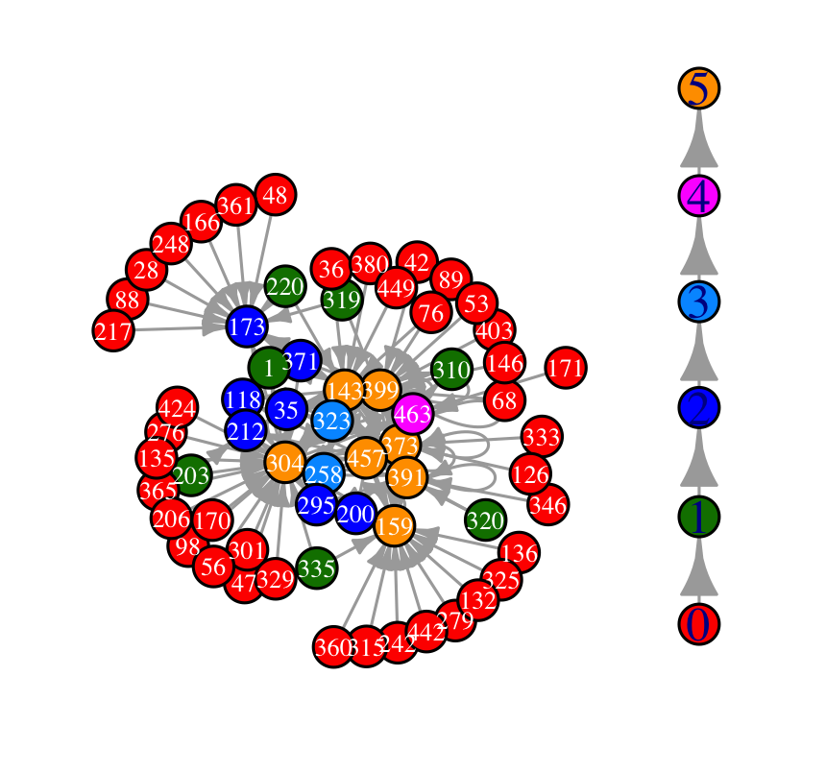
Talk network
Most cohesive
Computed cohesive blocks for “talk” network
64 actors
WG1={304, 143, 399, 463, 373}
WG2={304, 35, 22, 212, 319}
Least cohesive

Slide 18
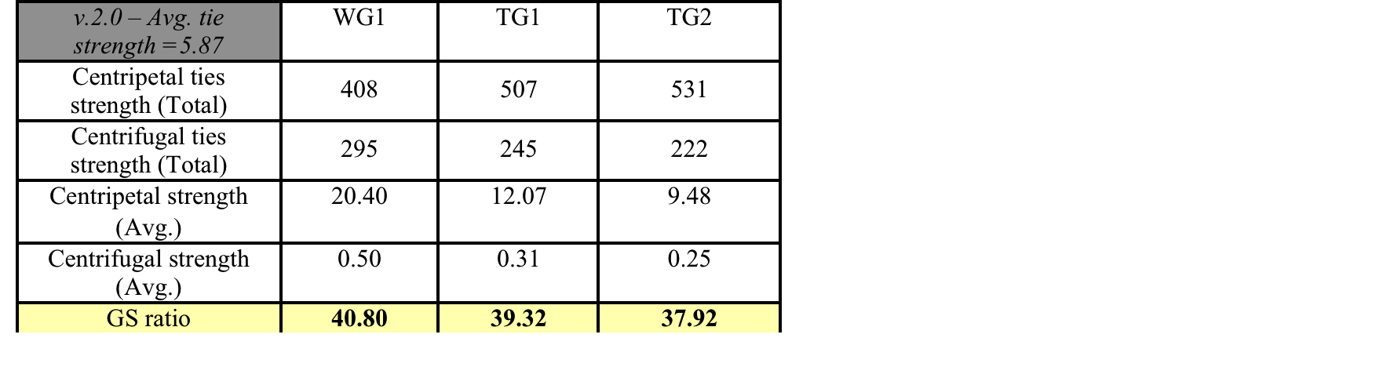
Example: Mylyn v.2.0
Analysis of group strength, based on talk network topology

Slide 19
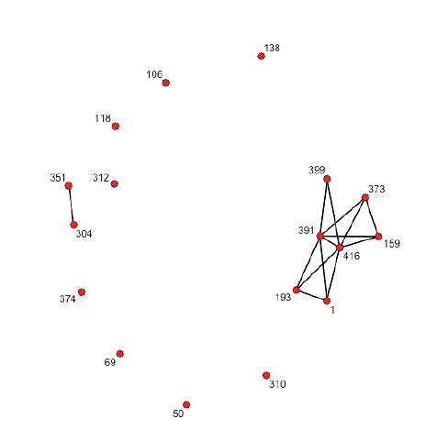
More results
Two 4-people cliques
Held together by #391 and #416
Correlation = 1
#399 is one of the longest-tenured Mylyn developers
#304 is handling another side project
Mylyn project: release 3.3

Slide 20
Team awareness – bottom line
Empirical work demonstrated the value accuracy of our method
And of our data
Fine point: our experiment was retrospective …
… but the data is not!!
Context records are recorded “live” as developers
Data can be leveraged to study VO collaborations as they emerge
Actionable support to members and managers

Slide 21
What’s next

Slide 22
Studying VOs
“Weakly held belief” about VOs:
Structural flexibility and fluid participation models are an advantage
Advantage = some benefit with respect to the work they need to perform
Can we prove/disprove this belief?
NSF VOSS project

Slide 23
Stuctural fluidity of VOs
We postulate we can define a metric of how “fluid” various VOs are
Structural fluidity: multi-faceted
Temporal analysis of macro-properties of the social network of the VO
Temporal variability of the ego-networks of VO members
Temporal leadership trajectory of individuals within the network

Slide 24
Stuctural fluidity of VOs
We postulate we can define a metric of how “fluid” various VOs are:
SW development
E-learning
Disaster recovery
…
We will compare performance data to different values of structural fluidity metric
We are analyzing the (huge!) GitHub SW development community

Slide 25
Finally, BIG data!
Github is these days the largest community of Open Source projects
Data is rich and long
Data is also big
Communities span multiple projects, or family of projects
All development work occurs “on stage”* with fine granularity thanks to social media integration
Mining GitHub integrated web repository requires Big Data tools
* [Dabbish et al., 2012]

Slide 26
Investigating structural fluidity on GitHub
We can study emergent teams in very large organization
And see how stable they are
Hypothesis: they are impromptu and ad hoc
Longitudinal samples of multiple metrics on a given community
Statistical analysis of time series
to evaluate whether metrics have significant trends
or are volatile

Slide 27
Thank You

Slide 28
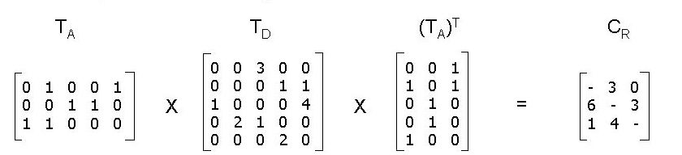
Detecting CRs [Cataldo et al. 2006]
Coordination requirements emerge between developers working on dependent tasks.
Each matrix is an observable relationship
Dependencies among Tasks
Coordination Requirements
Task Assignments
Cataldo, M., Wagstrom, P. A., Herbsleb, J. D., and Carley, K. M. 2006. Identification of Coordination Requirements: Implications for the Design of Collaboration and Awareness Tools. CSCW 2006

Slide 29
Conceptualization of CRs
Task Assignments
Committed code in SCM
Task dependencies
Approximated as artifact dependencies
Task conceptualization
Artifacts committed for task
(Subset of whole working set)
All relationships are visible only after the work is completed
Coordination requirement
P_{i}
P_{j}
Developer A
Developer B
Assigned to Task 1
Assigned to Task 2
S_{a}
S_{b}
Technical
dependencies
Coordination requirement
Dev A, Task 1
Working Set
Dev B, Task 2
Working Set

Slide 30
Problem: Make CRs actionable
Need to re-conceptualize CRs
Use “live” traces of developers’ activity to detect CRs as they form
Enable timely recognition
Timely recognition → actionable CRs → induces awareness
How?

Slide 31
Mylyn Context Data
Existing technology enables recording of developers’ actions in their IDEs
IDE logging, interaction traces …
Example: the Mylyn Eclipse plugin
one of the most downloaded Eclipse plugins
Supports the individual developer
Task-centered interface: focuses the Eclipse IDE on the information relevant to the task-at-hand
Collects task contexts
Type of action: {selection
Structure Handle
org.eclipse.mylyn.pde.ui/src.org.eclipse.mylyn.internal.pde.ui {PdeUiBridgePlugin.java[PdeUiBridgePlugin~lazyStart
Structure Kind
java
Date
2007-10-28 22:16:00.118 EDT

Slide 32
Mylyn Context Data
Type of action
Selection, edits and more
Structure Handle
org.eclipse.mylyn.pde.ui/src.org.eclipse.mylyn.internal.pde.ui {PdeUiBridgePlugin.java[PdeUiBridgePlugin~lazyStart
Structure Kind
java
Date
2007-10-28 22:16:00.118 EDT
Notes:
Point out granularity and all contributors get fair credit here

Slide 33
New CR conceptualization
Starting point: intersection between working sets as work progresses
Consider the type of actions each developer has done on the artifacts (action weight)
Consider how much each developer has “used” the intersection artifacts (# of events)
End result: proximity
a quantitative measure of the strength of the need to coordinate
Coordination requirement
Developer A
Developer B
Assigned to Task 1
Assigned to Task 2
Dev A, Task 1
Working Set
Dev B, Task 2
Working Set
Intersection

Slide 34
Proximity Algorithm
Developer X Working Set
Developer Y Working Set
a.java
b.java
b.java
c.java
3 selects
8 selects, 7 edits
3 selects
7 selects, 4 edits
c.java
e.java
d.java
e.java
6 selects, 5 edits
1 select, 1 edit
5 selects, 2 edits
1 select, 1 edit
Potential Overlap = 4.59
a.java
b.java
c.java
d.java
e.java
3 selects
8 selects, 7 edits
7 selects, 5 edits
5 selects, 2 edits
1 select, 1 edit
.59 + 1 + 1 + 1 + 1

Slide 35
Proximity Algorithm
Developer X Working Set
Developer Y Working Set
a.java
b.java
b.java
c.java
3 selects
8 selects, 7 edits
3 selects
7 selects, 4 edits
c.java
e.java
d.java
e.java
6 selects, 5 edits
1 select, 1 edit
5 selects, 2 edits
1 select, 1 edit
Actual Overlap = 2.79
b.java
c.java
e.java
3 selects
6 selects, 4 edits
1 select, 1 edit
0 + .79 + 1 + 0 + 1
Number of Overlapping Events = 15

Slide 36
Proximity Algorithm
Proximity = Actual / Potential * Scaling Factor
Scaling Factor = Number of Overlapping Events / Average number across pairs
Various levels of aggregation:
pairs of contexts
pairs of tasks
pairs of developers
pairs of teams

Slide 37
Does proximity work?
RQ1 (analogy): Is it an effective proxy for CRs?
RQ2 (accuracy): can we use the detailed context information to better detect CRs than current methods?
RQ3 (timeliness): can proximity allow for early, detection and make CR actionable for awareness?
We have explored these questions using Mylyn data from the Mylyn development itself

Slide 38
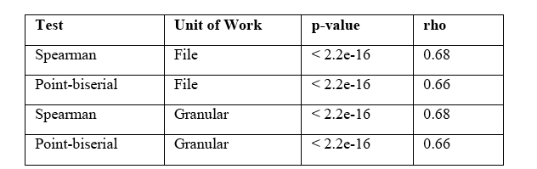
RQ1: analogy
Correlation of proximity scores vs. presence of CRs (according to Cataldo et al.)
Correlation of proximity scores vs. amount of CRs

Slide 39
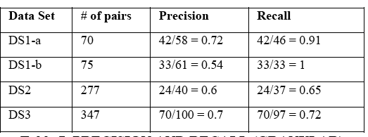
RQ2: accuracy
Precision and recall
We used Cataldo et al. to approximate “ground truth”
Manual analysis of false positives and false negatives
Proximity tends to be “right” in both cases
Notes:
Moving to potential false negatives, we examined the 16
pairs of committers in DS1-a that present some amount of
granular proximity but have no CR.
For potential false positives, we reviewed the four cases in
DS1-a where developer pairs with CRs had granular
proximity=0.

Slide 40
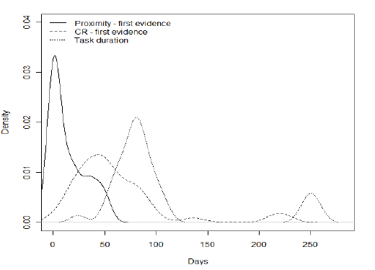
RQ3: timeliness
Data set 1 (Committers)
Concurrent work 102 days
CRs detected 60.7 days after parallel work begins
Proximity detected 14.2 days after parallel work begins
46.5 days sooner
Data set 2 (Contributors)
Concurrent work 31.4 days
CRs detected 17.9 days after parallel work begins.
Proximity detected 6.2 days after parallel work begins
11.7 days sooner
Probability density of first evidence of Proximity v CRs
Notes:
Fig. 3 shows the probability density functions
of proximity detection, CR detection and task duration for
data set DS1-a. The difference in the timeliness of
recognition of work relationship shown is evident.

Slide 41
Timeliness results (avg.)
Data set 1 (Mylyn committers)
Concurrent work 102 days
CRs detected 60.7 days after parallel work begins
Proximity detected 14.2 days after parallel work begins
46.5 days sooner
Data set 2 (Mylyn contributors)
Concurrent work 31.2 days
CRs detected 16.9 days after parallel work begins.
Proximity detected 5.8 days after parallel work begins
11.1 days sooner

Slide 42
Proximity: results recap
Proximity for pairs of developers correlates well with presence and number of CRs
Qualitative analysis of recall hints at more accurate representation of actual coordination needs
Proximity offers early CRs detection, makes them actionable

Slide 43
Where to go from there?
Create proximity-based tool to detect Coordination Requirements in real-time
Make developers and project leaders aware of impending CRs
Rank CRs in real time
Highlight the artifacts involved in each CR and make developers’ actions on those artifacts translucent
Team awareness: extension from pairs to groups
Watch how emergent teams form and evolve
Of interest in fluid and unstructured collaborative work environments (SW development VOs)
Are all CRs “created equal”?
Proximity gives us an actionable look at work inter-dependencies
BUT do developers always have to coordinate when work dependencies exist?

